Slide 1
Putting your skills to the test
Easton White
Alan Hastings
Winter 2018

Slide 2
Learning objectives
By the end of today:
Apply the tools you have learned in this class to various examples
Understand the final homework assignment

Slide 3
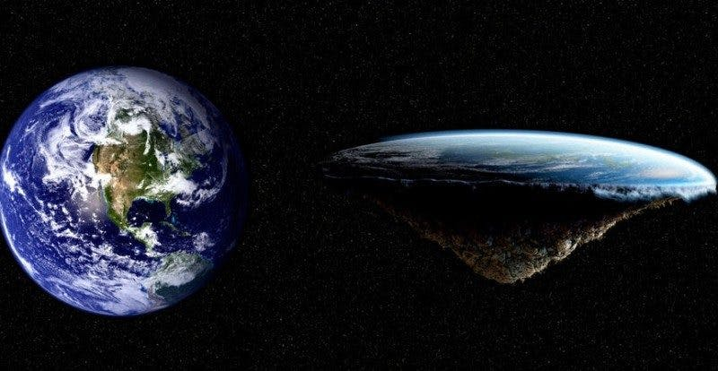

Slide 4
How would you determine if the earth is flat or round?
Think-pair-share activity
Notes:
https://www.popsci.com/10-ways-you-can-prove-earth-is-round#page-16
http://bigthink.com/stephen-johnson/understanding-the-really-ridiculous-core-tenets-of-the-flat-earth-hypothesis

Slide 5
Spherical earth
Flat earth
Earth orbits the sun, and the moon orbits the Earth
Gravity does exist
The moon landing provide photos of the spherical Earth
Satellites and GPS orbit the Earth
Northern lights are caused by charged particles hitting molecules at the north pole (where Earth’s magnetic field is weaker)
The sun and moon are the same size, and they both orbit Earth
Gravity does not exist
Moon landing and other NASA missions were faked
Satellites work because they are attached to balloons
Northern lights are just holograms

Slide 6
What fallacies are the flat-earthers committing?

Slide 7
What fallacies are the flat-earthers committing?
Not employing Occam’s razor
Ad hoc explanations
Argument from incredulity or argument from ignorance

Slide 8
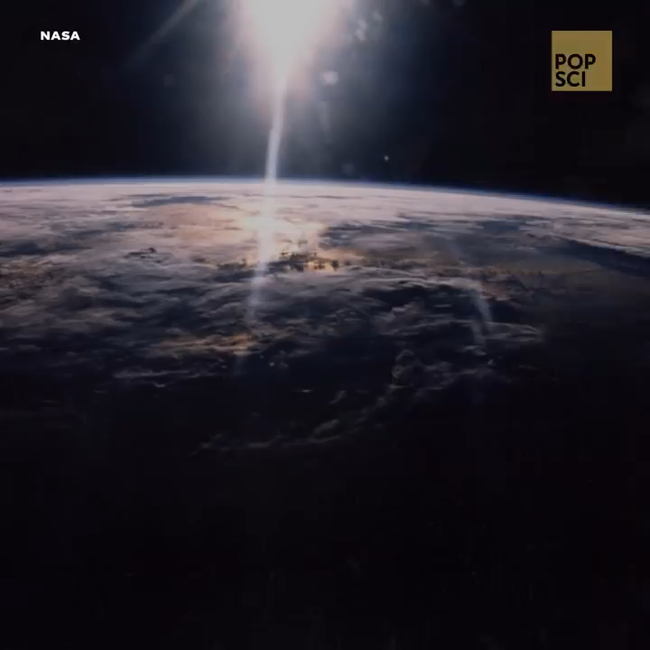

Slide 9
Science versus pseudoscience
Notes:
https://www.quackwatch.org/01QuackeryRelatedTopics/pseudo.html

Slide 10
Science versus pseudoscience
Scientific ideas can at least in principle be tested and are falsifiable
Scientific findings are expressed in peer-reviewed journals
Notes:
https://www.quackwatch.org/01QuackeryRelatedTopics/pseudo.html

Slide 11
Science versus pseudoscience
Scientific ideas can at least in principle be tested and are falsifiable
Scientific findings are expressed in peer-reviewed journals
Pseudoscience avoids putting claims to the test
Pseudoscience may appeal to emotion, authority, ignorance, or other logical fallacies
Pseudoscience does not apply Occam’s Razor
Notes:
https://www.quackwatch.org/01QuackeryRelatedTopics/pseudo.html

Slide 12
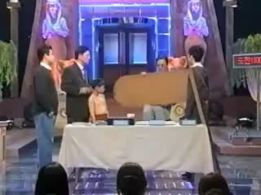

Slide 13
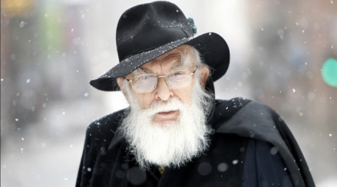
James Randi prize
One Million Dollar Paranormal Challenge (1964-2015)
Must demonstrate some type of paranormal ability or behavior
1000 failed applicants, no one has claimed the prize
Notes:
https://en.wikipedia.org/wiki/List_of_prizes_for_evidence_of_the_paranormal

Slide 14
Why is this important?
Notes:
https://www.actcm.edu/news/americans-spend-34-billion-on-alternative-medicine/
https://finance.yahoo.com/news/psychic-industry-fortune-tellers-ibisworld-221118482.html

Slide 15
Why is this important?
Americans spend about $2 billion per year on fortune telling
Americans spend about $3 billion per year on homeopathic medicine
Americans spend about $28 billion per year on supplements that have not been shown to have an effect
And so forth…
Notes:
https://www.actcm.edu/news/americans-spend-34-billion-on-alternative-medicine/
https://finance.yahoo.com/news/psychic-industry-fortune-tellers-ibisworld-221118482.html
http://articles.latimes.com/2013/dec/17/science/la-sci-sn-vitamin-supplements-waste-of-money-20131217

Slide 16
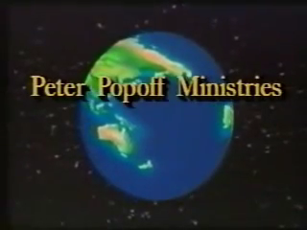
Notes:
Peter Popoff

Slide 17
Homework for next week
Go back to Sagan’s baloney detection kit. Choose one of the tools he discussed OR create your own. Explain how the tool works.
Then, show an example of the tool applied to a news article, politician speaking, Youtube video, or something else
It is due by the 16th March (Friday) at midnight

Slide 18
For example
Possible tools I could use:
non sequitur (Latin for it doesn’t follow)
Suppressed evidence

Slide 19
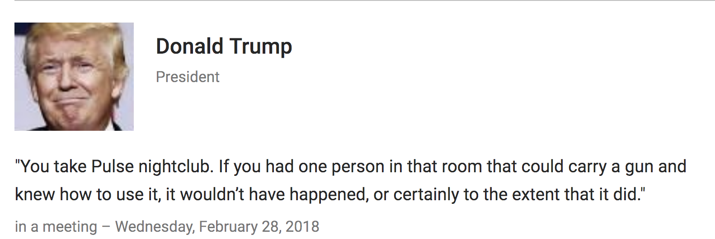
For example
Possible tools I could use:
non sequitur (Latin for it doesn’t follow)
Suppressed evidence

